Slide 1

Smart Monitoring System for Weather and Tsunami Detection (SMSWTD)
Group 10:
Rezene Gebreslassie
Baigalmaa Bayarsaikhan

Slide 2
System Mission
To minimize loss of life and property by enhanced cutting edge solutions of disaster prediction, resilience and response.
Objectives:
Provide real-time, actionable insights
Technological advance in monitoring weather conditions
Predict severe weather events and tsunamis with state-of-the-art solutions
Mitigate natural disaster by spreading accurate and timely information

Slide 3

Vision
To be initiative technology to save lives at the risk of severe weather conditions by leveraging real-time, cutting-edge advanced solutions.

Slide 4

Values
Flexibility
Accuracy
Safety
Collaboration
Accessibility
Stability

Slide 5
Contradictions
Accuracy vs Speed: Prioritizing accuracy over speed in delivering real-time insights, it possible to lead to inaccurate information being provided
Cost Efficiency vs Cutting-Edge Technology: The system might face a budget constraint. Cutting-edge technology is often expensive. The prediction accuracy and real-time monitoring capability could be reduced due to the cost.
Predictive Accuracy vs Public interpretation: if the system focuses too much on predictive accuracy, it may fail to create public awareness that help the system interpret the information.

Slide 6
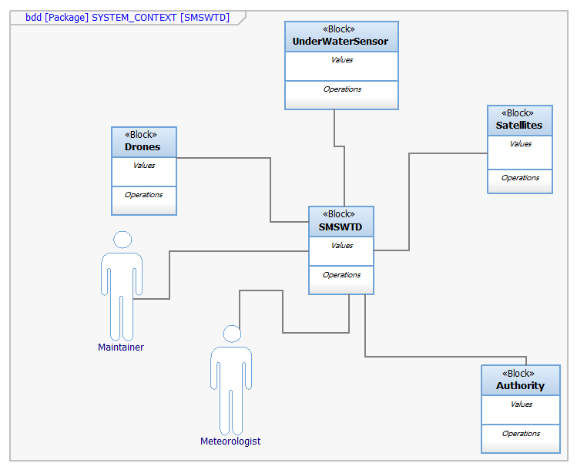
System Context

Slide 7
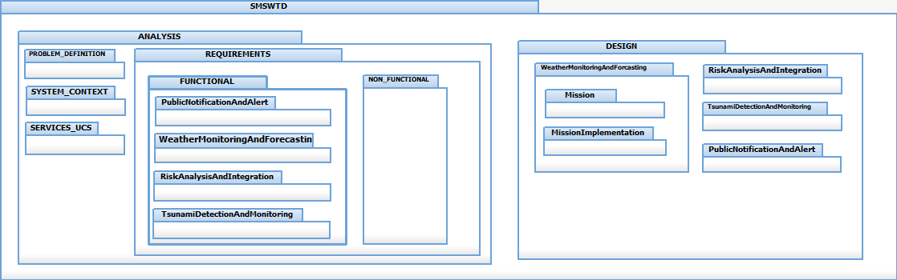
Package Diagram

Slide 8
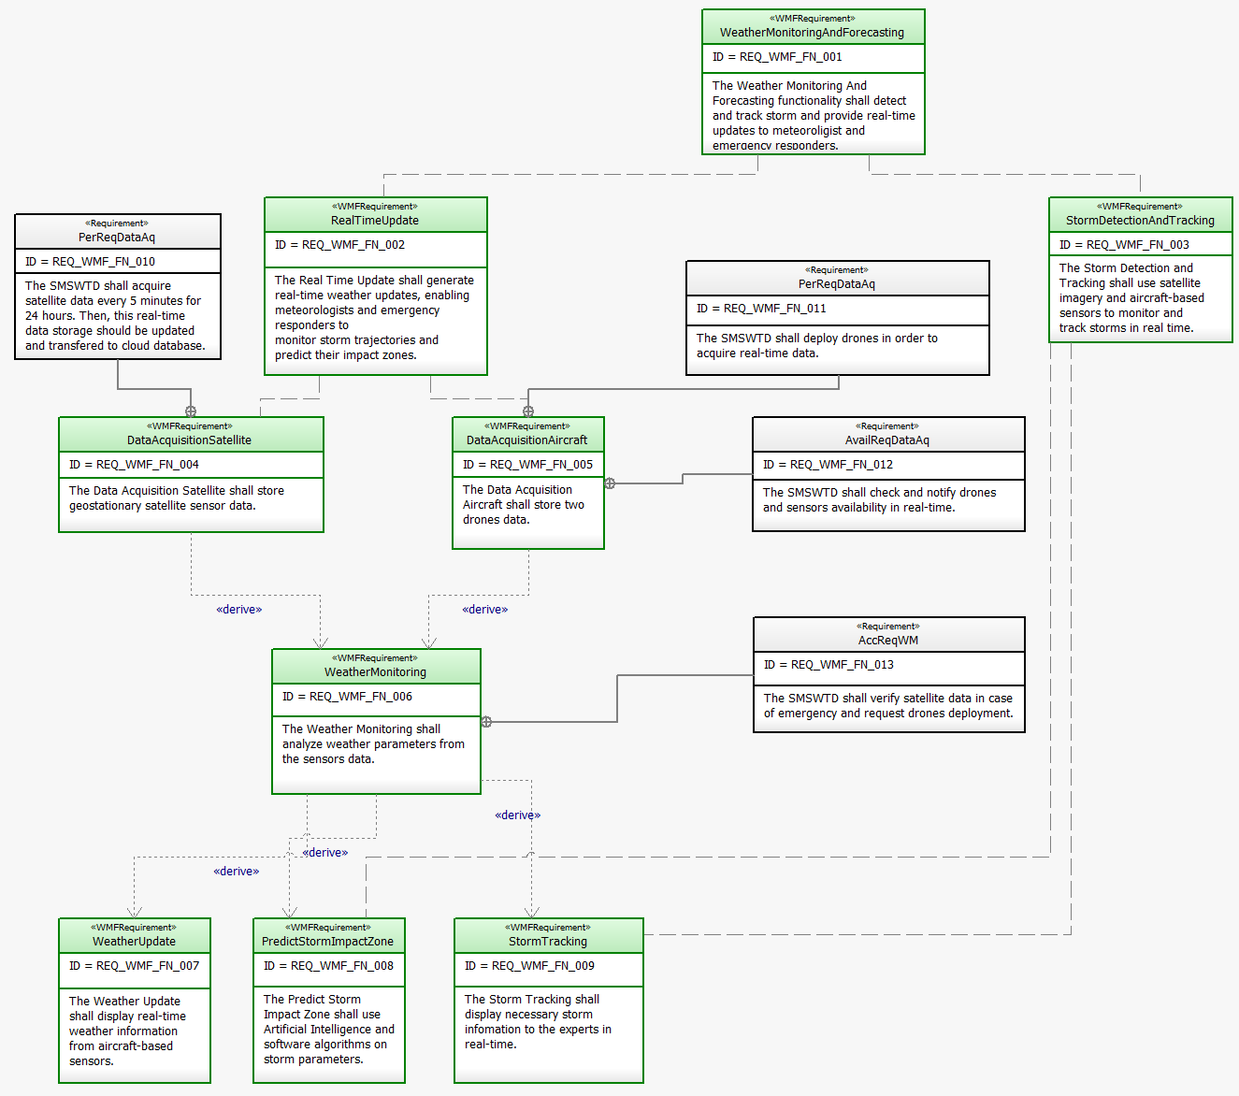
System Requirements

Slide 9

Demo

Slide 10

Thank you

